Slide 1


Slide 2

Comparative Study Between

Slide 3
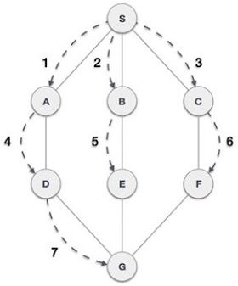
Breadth-First Search
algorithm for traversing or searching tree
starts at the tree root, and explores all of the neighbor nodes.

Slide 4
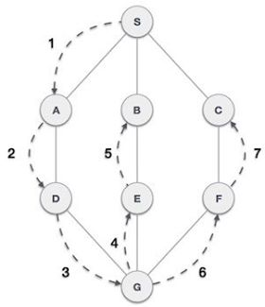
Depth-First Search
algorithm for traversing or searching tree
starts at the root node and explores as far as possible along each branch

Slide 5
Time Complexity :
BFS
0 (V+E)
DFS
0 (V+E)

Slide 6
Difference between BFS & DFS
Queue
Slower
Optimal solution
Stack
Faster
Not-optimal solution
BFS
DFS

Slide 7
Advantages
Find opimal solution
Search level by level
Find closest goal
Better reliability
Extended permission
Increased security
BFS
DFS

Slide 8
Dis-advantages
Consume more memory
Connected vertices must be stored
Not find optimal solution
Get trapped in searching
BFS
DFS

Slide 9
When which is better?
BFS
For Puzzle game
When Target is closer
DFS
For decision tree
When target is far

Slide 10


